Slide 1
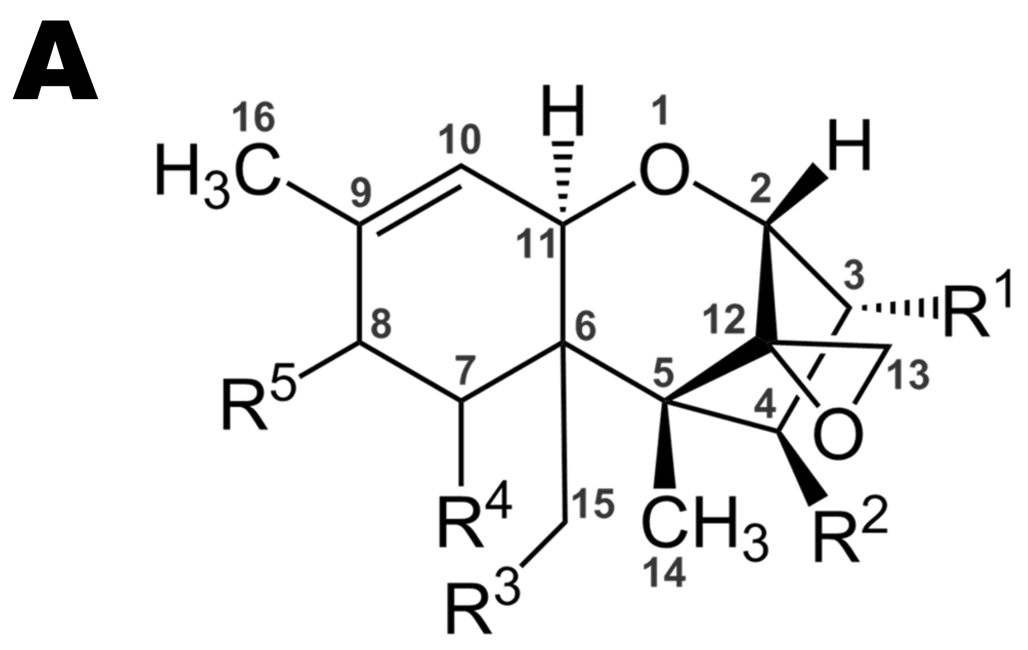
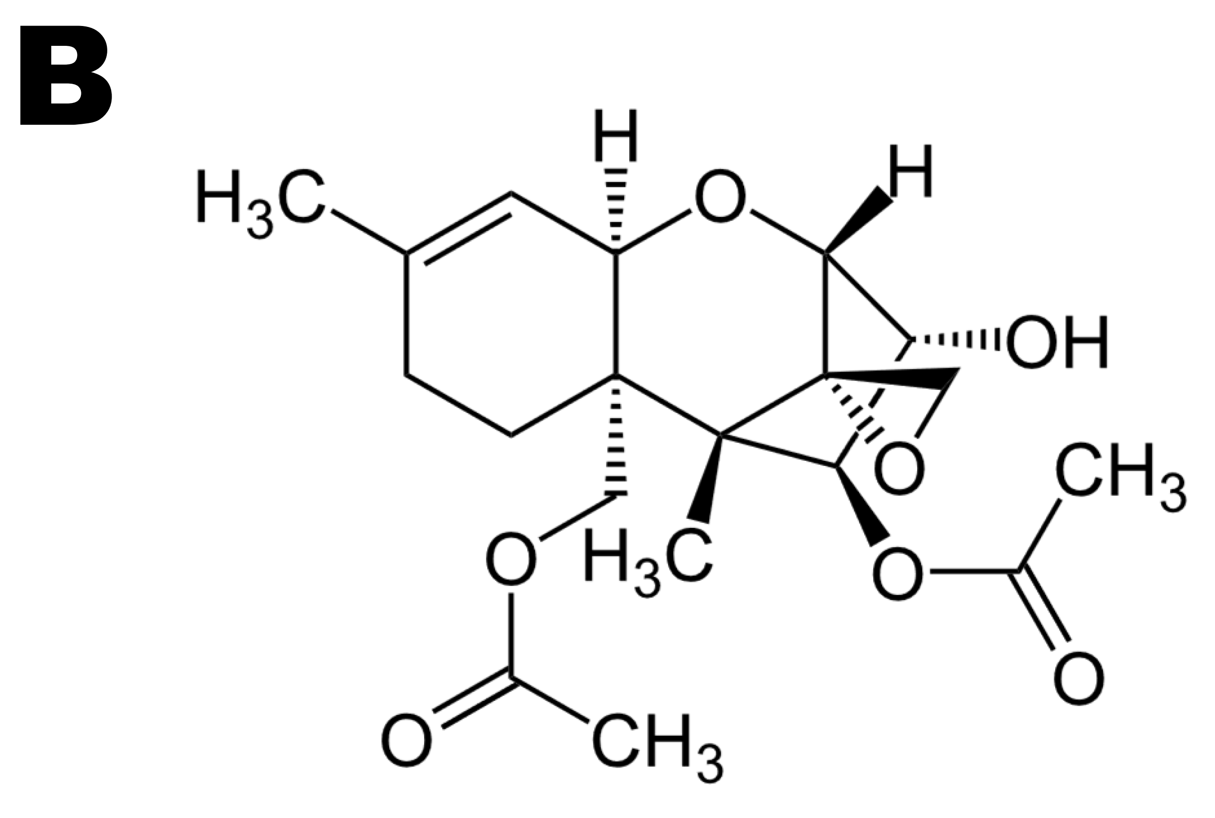
Diacetoxyscirpenol, a Fusarium spp. exometabolite, prevents efficiently the incidence of the parasitic weed Striga hermonthica
Williams Oyifioda Anteyi¹, Iris Klaiber², Frank Rasche¹*
¹Institute of Agricultural Sciences in the Tropics (Hans-Ruthenberg-Institute), University of Hohenheim, 70593 Stuttgart, Germany.
²Core Facility Hohenheim, University of Hohenheim, 70593 Stuttgart, Germany.
*Corresponding author:
Prof. Dr. Frank Rasche
Email: frank.rasche@uni-hohenheim.de
Supplementary Information. Chemical structures of (A) trichothecene core, and (B) diacetoxyscirpenol (DAS). The chemical structures of trichothecene core and diacetoxyscirpenol were adapted from Fk (2005) and Yikrazuul (2009) respectively.
Fk (2005). Chemical structure of Trichothecenes.
https://en.wikipedia.org/wiki/Trichothecene#/media/File:Trichothecenes.png
Yikrazuul (2009). diacetoxyscirpenol; Anguidine; diacetoxyscirpenol; Anguidin; 4,15-Diacetoxyscirpenol.
https://en.wikipedia.org/wiki/Diacetoxyscirpenol#/media/File:Diacetoxyscirpenol.svg

